Slide 1




Holly King
Digital Portfolio

Slide 2
Links to Holly King Portfolio
Linked in:
GitHub:

Slide 3
My inspiration for my portfolio site was based on being personable and a genuine reflection of who I am -friendly, happy, bright.
Inspiration

Slide 4
The portfolio had to represent who I am.
Had to be simple
Had to have a welcoming friendly feeling
Had to make you feel happy and Bright when looking at it.
Had to have a smooth user experience
1.Project Plan :Define the Goals and Objectives of my site

Slide 5
Purpose: Connect with potential employers
(Target Audience)
Decide functions
Think about design process
Organise mood/color boards
Draw mockup/sketches
Plan Out wireframe
Process …….

Slide 6
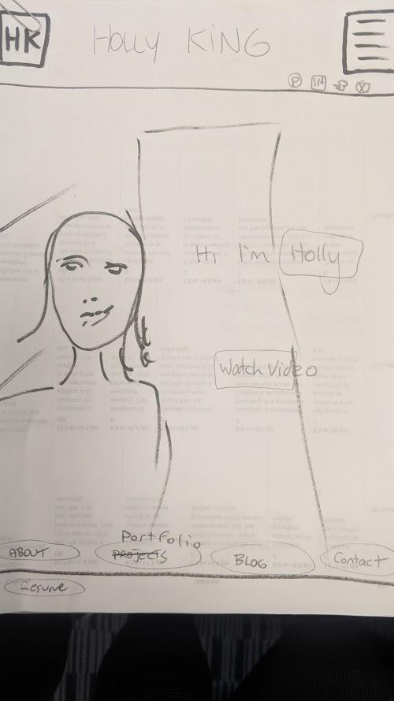
Sketches

Slide 7
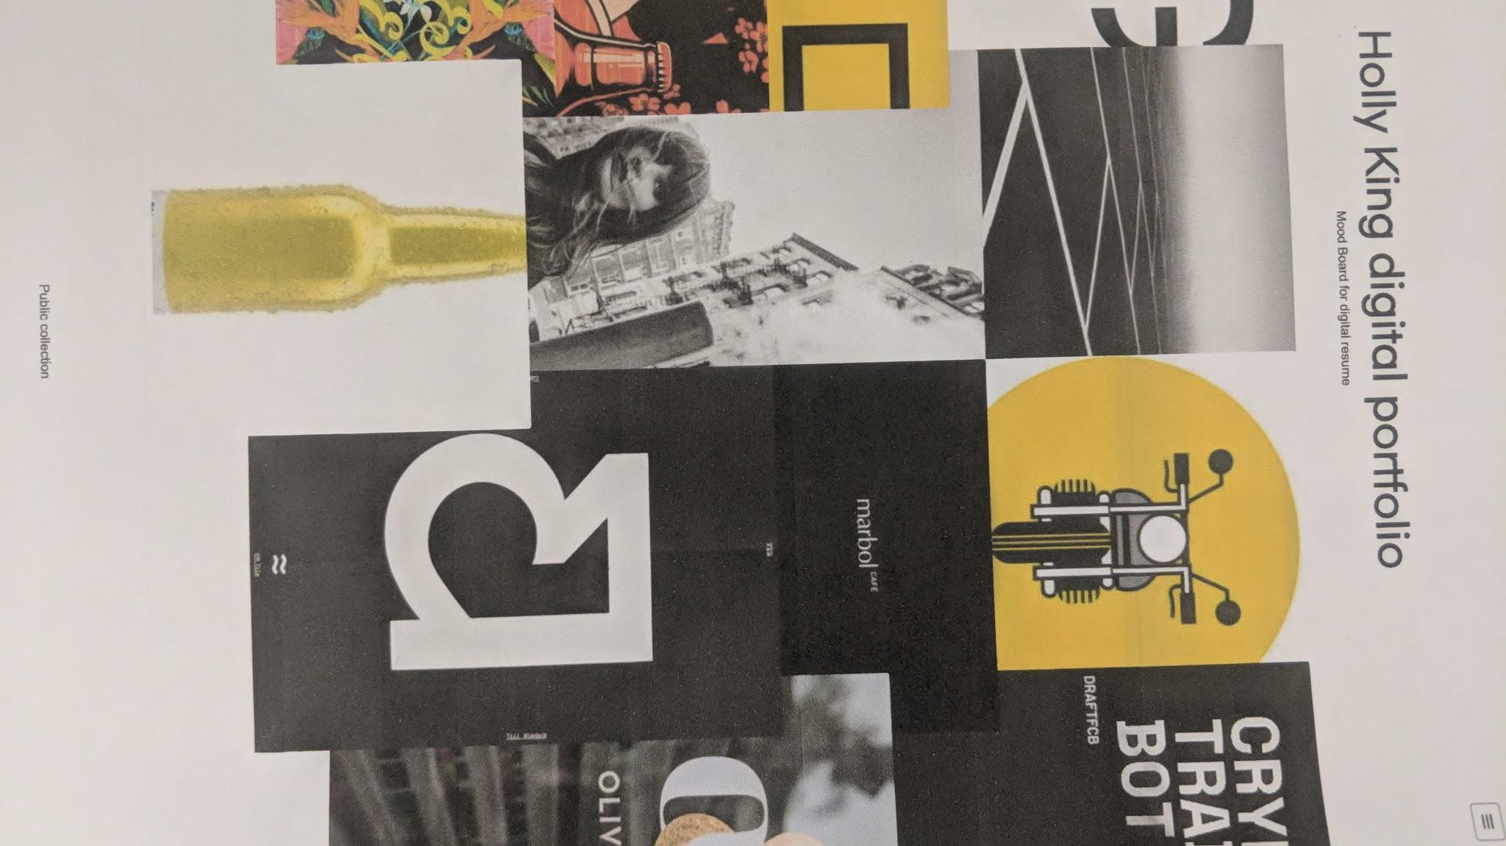
Mood Board 1

Slide 8
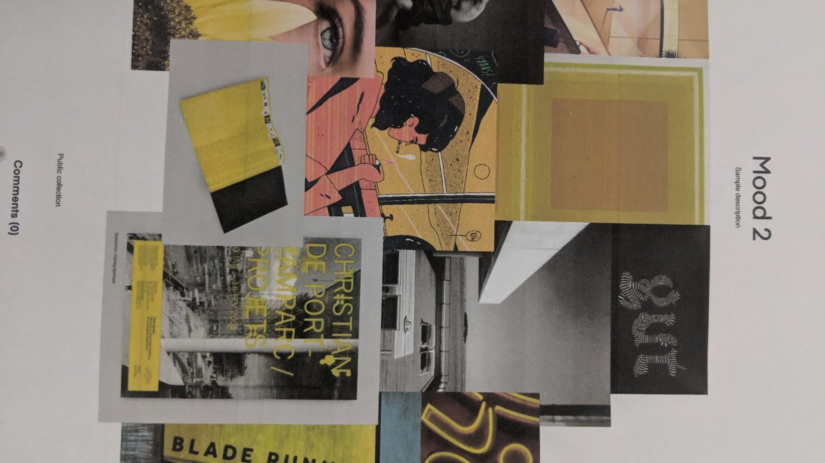
Mood Board 2

Slide 9
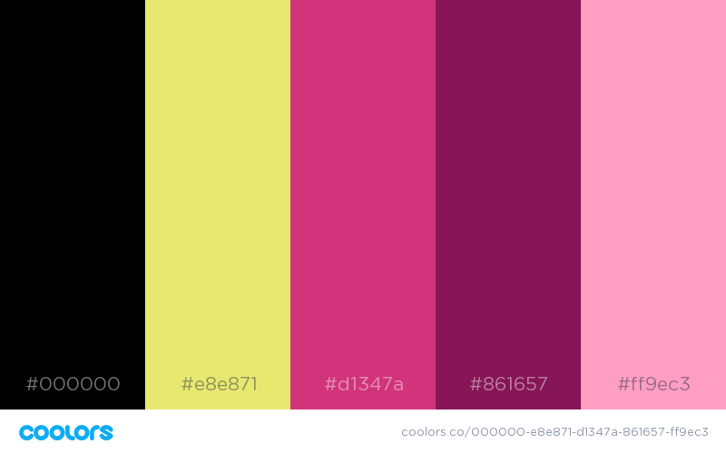
Colors

Slide 10


Logo designs

Slide 11
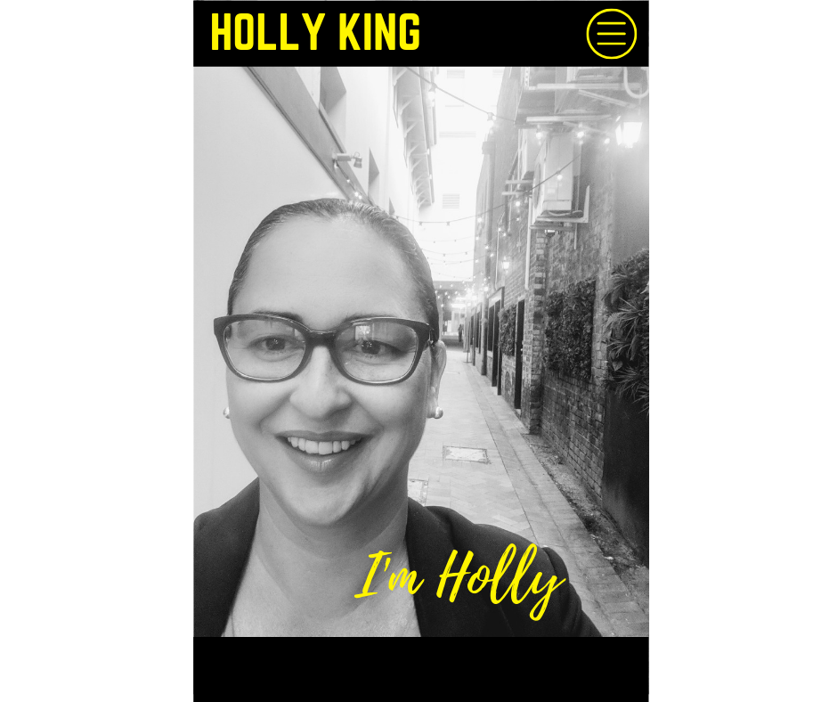
Mockups 1

Slide 12
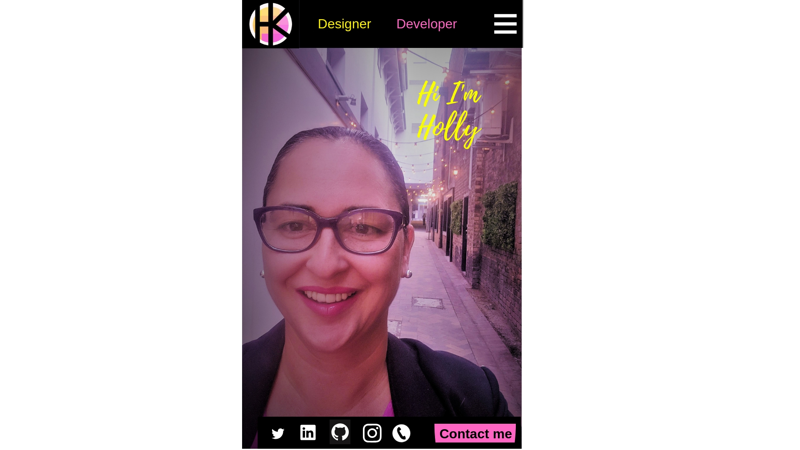
Mock…. 2

Slide 13
Fonts
Verdana
Geneva
Tahoma
Sans-serif
Went to font awesome but in the end decided to choose these combination of fonts as they were simple.

Slide 14
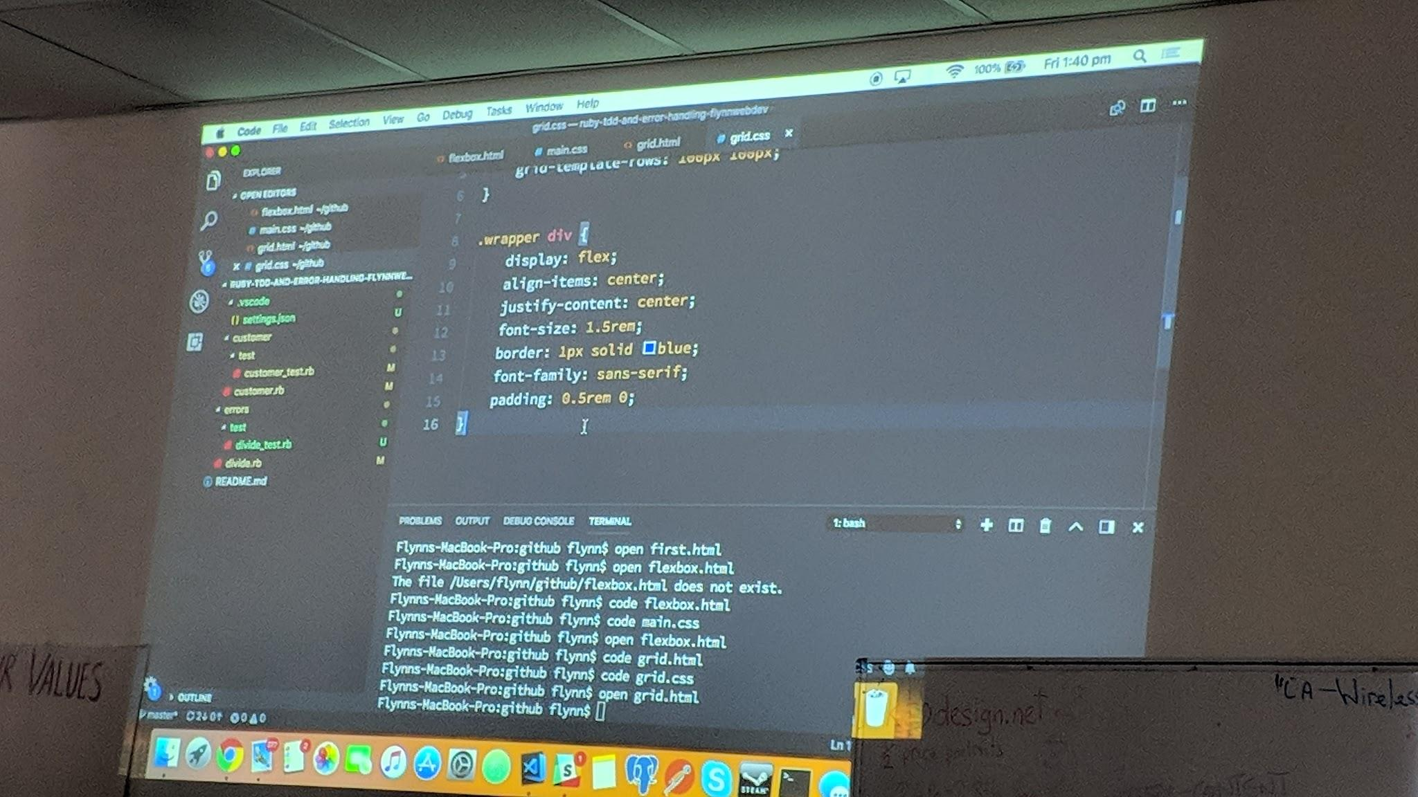
Decided to keep Tech Stack Simple = current skill level Sept 2018
HTML
CSS

Slide 15
Went to JustinMind and did a wireframe mockup
2.Create a Wire Frame

Slide 16
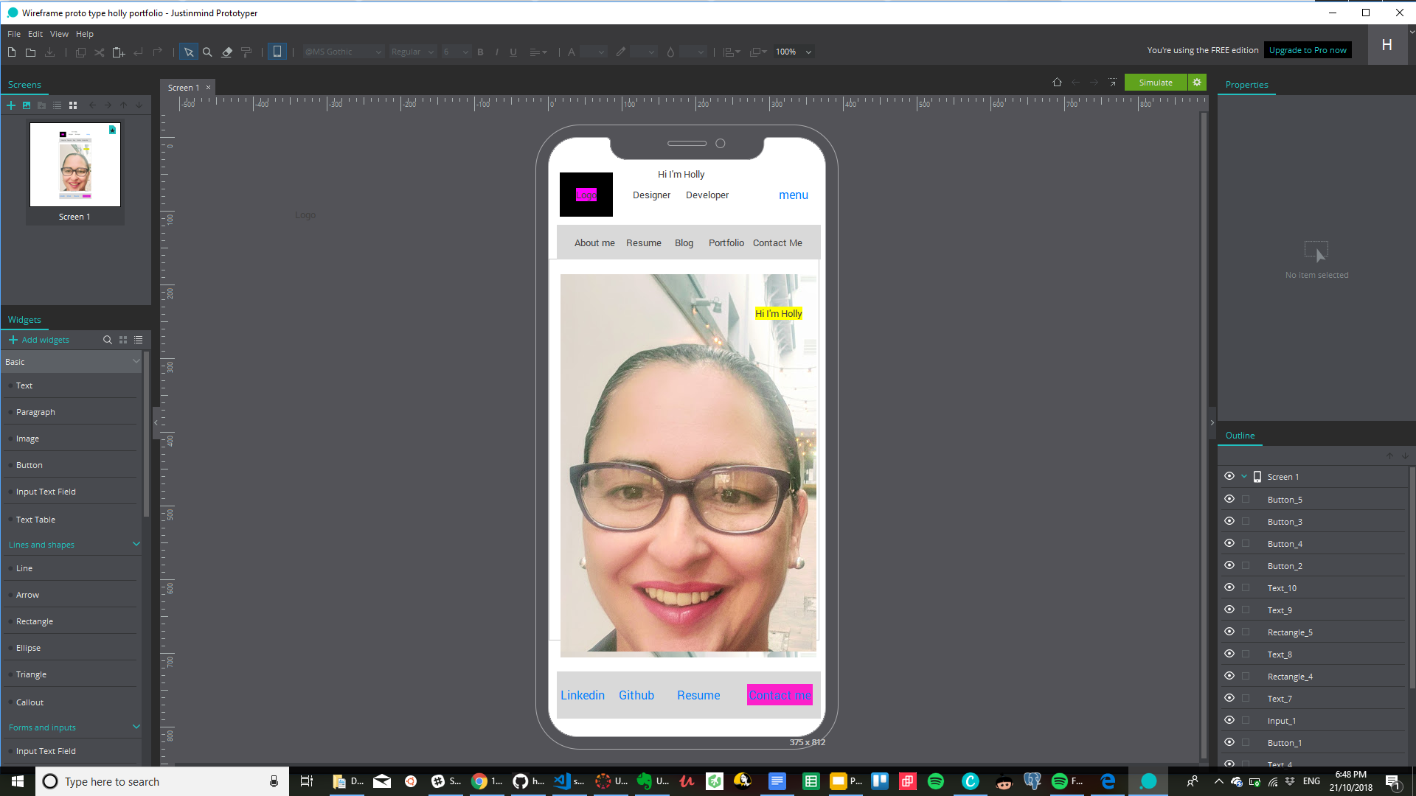

Slide 17

Organised content
And created a content list
About me
Skills (resume)
Contact me
Blog

Slide 18
Task list
Header-container
1. Logo
2. menu
- Home
- About me
- skills/education/resume
- contact me
3. masthead
- background image to be loaded
- header title &
- paragraph
4. Aspiration
- designer
- developer

Slide 19
07
08
09
10
Define Inspirations, Goals and Objectives.
Organise Mood boards, Colors, Sketches, Mockups.Logo, Fonts
Create wireframe, Organise Content list, Consideration check list and Finalise Tech stack
Create /Break List down to tasks.
Establish a Timeline, site map and Navigation Structure

Slide 20
11
12
13
14
Write sudo code,
Write test driven code
W1
W2
W3
W4
W1
W2
Once site is operational, Check against web design and usability checklist,Comment clearly and refactor .
Create slide deck and Finalize all documentation. Submit all files and documentation.

Slide 21
Went through the usability Consideration Checklist: www.seanmacentee.com/checklists/web-design-usability-checklist

Slide 22
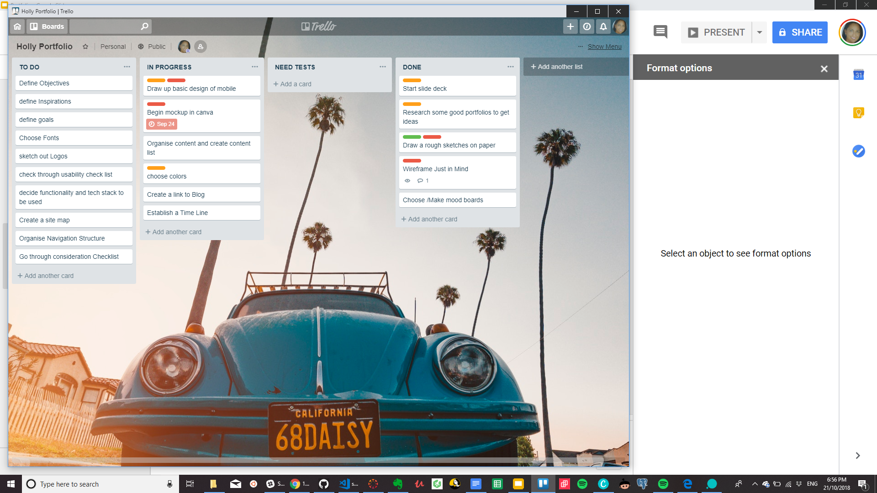
T
R
E
L
L
O

